Slide 1
The Big Picture

Slide 2
Versions
Version 1.x
Version 2.x
Version 3.x

Slide 3

Do you need to support IE 6, 7 or 8?

Slide 4
Versions
Version 1.x
Version 2.x
Version 3.x Compat
IE 6, 7 or 8

Slide 5
Versions
Version 1.x
Version 2.x
IE 9+
Version 3.x Compat
Version 3.x

Slide 6


jQuery lives in the JavaScript ecosystem.
— Me

Slide 7


jQuery in the Browser
Custom Widgets

Slide 8
jQuery in the Browser
Custom Widgets

Slide 9
jQuery in the Browser
Custom Widgets

Slide 10
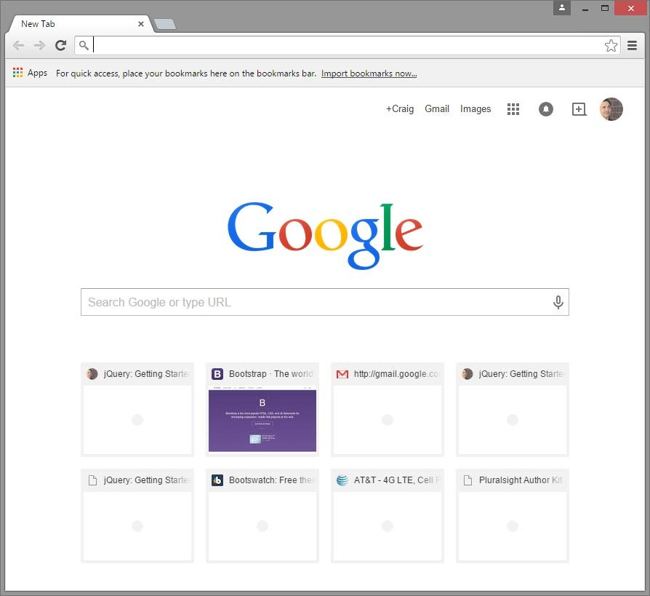



JavaScript on the Desktop and Server

Slide 11

Mobile and Device Development

Slide 12

Demo
function scope

Slide 16
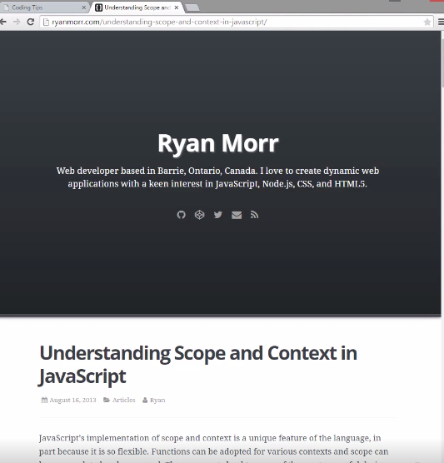

Slide 17
Demo
naming convention

Slide 18
Summary

Slide 19

jQuery in Context

Slide 20
Coding Techniques

Slide 21
jQuery Getting Started

